Slide 1
Trees

Slide 2
Properties of Trees
A tree is a graph that is connected and contains no cycles
Can start from any node and visit any other node
A tree with n nodes has n-1 edges
The node with an in degree of 0 is called the root node
Nodes can have parent nodes (the nodes that they came from) and child nodes (the nodes that they can traverse to)
The eccentricity of a node is the maximum distance from that node to any other node in the tree
The diameter of the tree is the maximum eccentricity
If there is a diameter, there is a radius

Slide 3
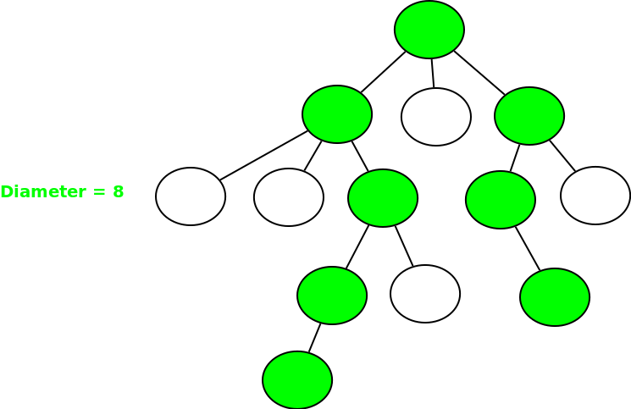
Tree Diameter
The longest distance between any two pairs of nodes in a tree
Always between two leaf nodes

Slide 4
Finding Tree Diameter
Run 2 DFS traversals
Run DFS from any node to find farthest node -> i
From node i, run another DFS to find farthest node j
Tree diameter is distance between nodes i and j

Slide 5
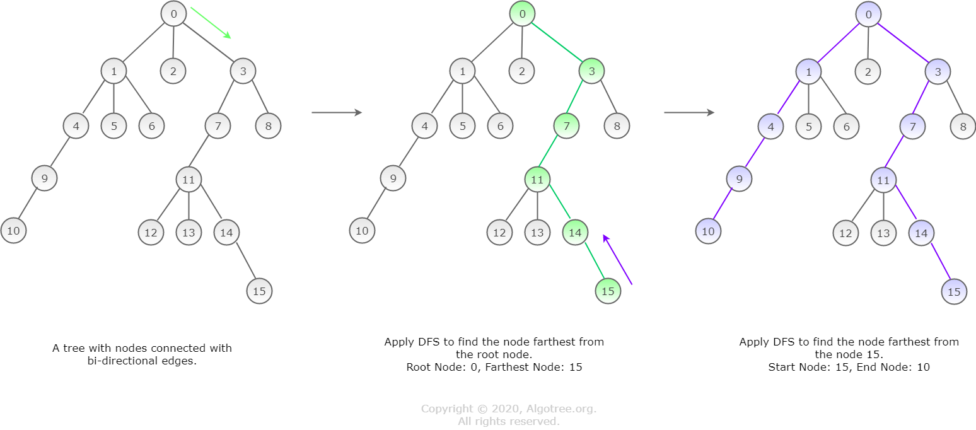
Algorithm Visualization

Slide 6
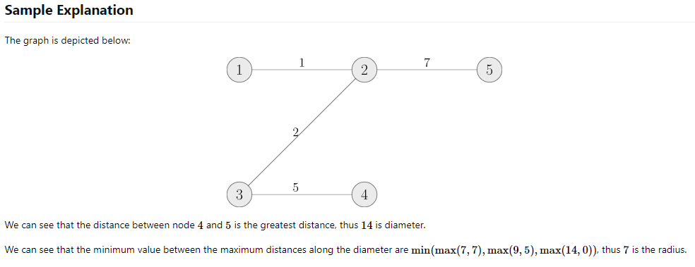
Tree Radius
Travel along the path of the tree diameter, keeping the weight of the edges visited and the weight of the edges not yet visited. The radius would be the minimum of the maximum of the edge weights on each iteration.

Slide 7
Additional properties
Distance needed to start at any node, visit all other nodes in the tree, and return back
→ 2 * Edges
Distance needed to start at a node (A), visit all other nodes in the tree
→ 2 * Edges - (Eccentricity of node A)
Distance needed to start at any node, visit all other nodes in the tree
→ 2 * Edges - (Diameter of the tree)

Slide 8
Problems
https://dmoj.ca/problem/wc18c3s2
https://dmoj.ca/problem/treepractice1
Challenge:
https://dmoj.ca/problem/ccc16s3
https://dmoj.ca/problem/bts16p5

